Slide 1



learn invent impact
Why the Atlas platform
Suresh C. Kothari
Department of Electrical and Computer Engineering
President & Founder EnSoft Corp.
Acknowledgement: Team members at Iowa State University and EnSoft, DARPA contracts FA8750-12-2-0126 & FA8750-15-2-0080

Slide 2
Try the subsequent Atlas queries + Do your own experiments with Atlas

Slide 3
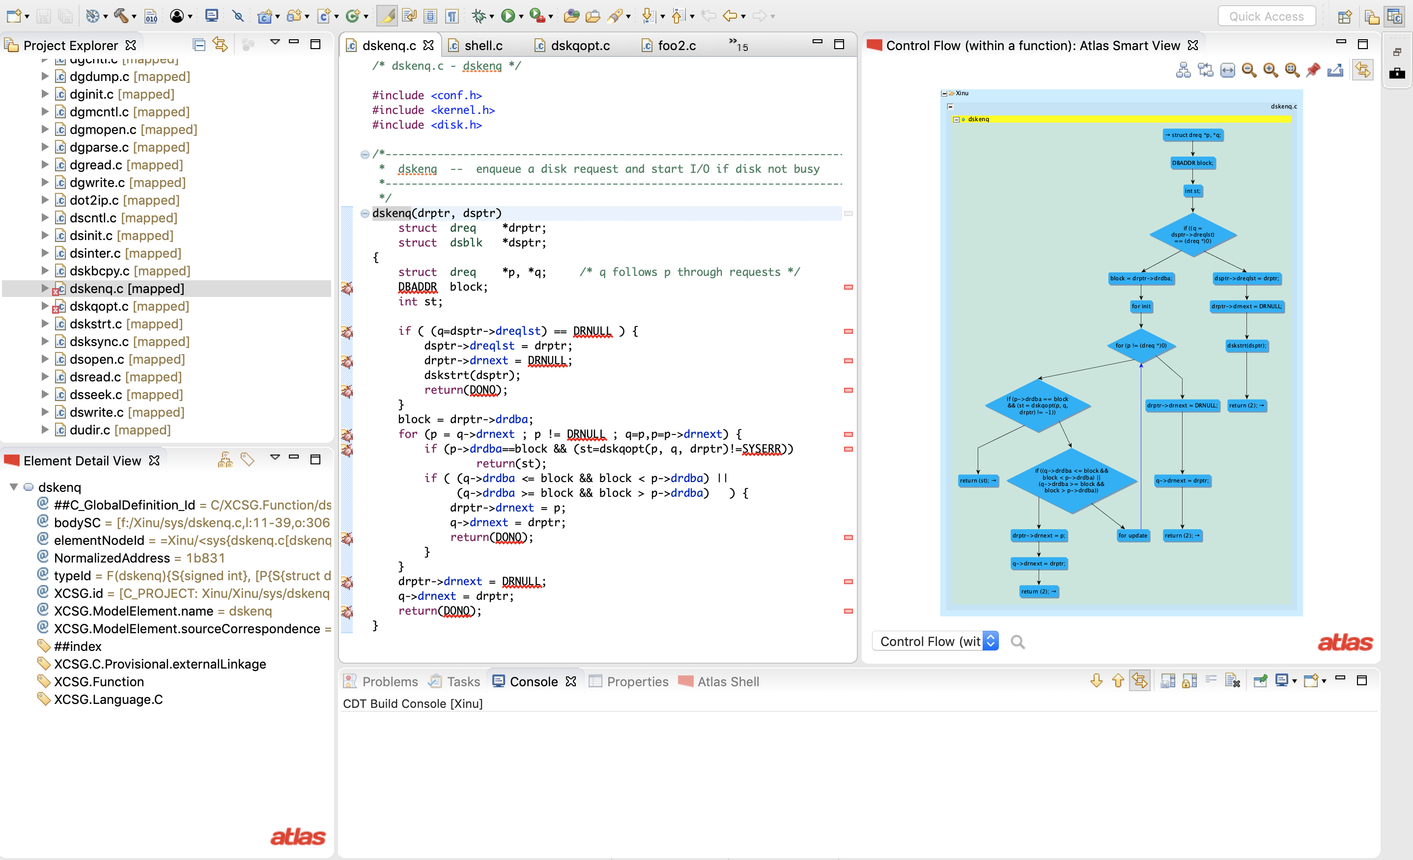
Click to pin the model

Slide 4
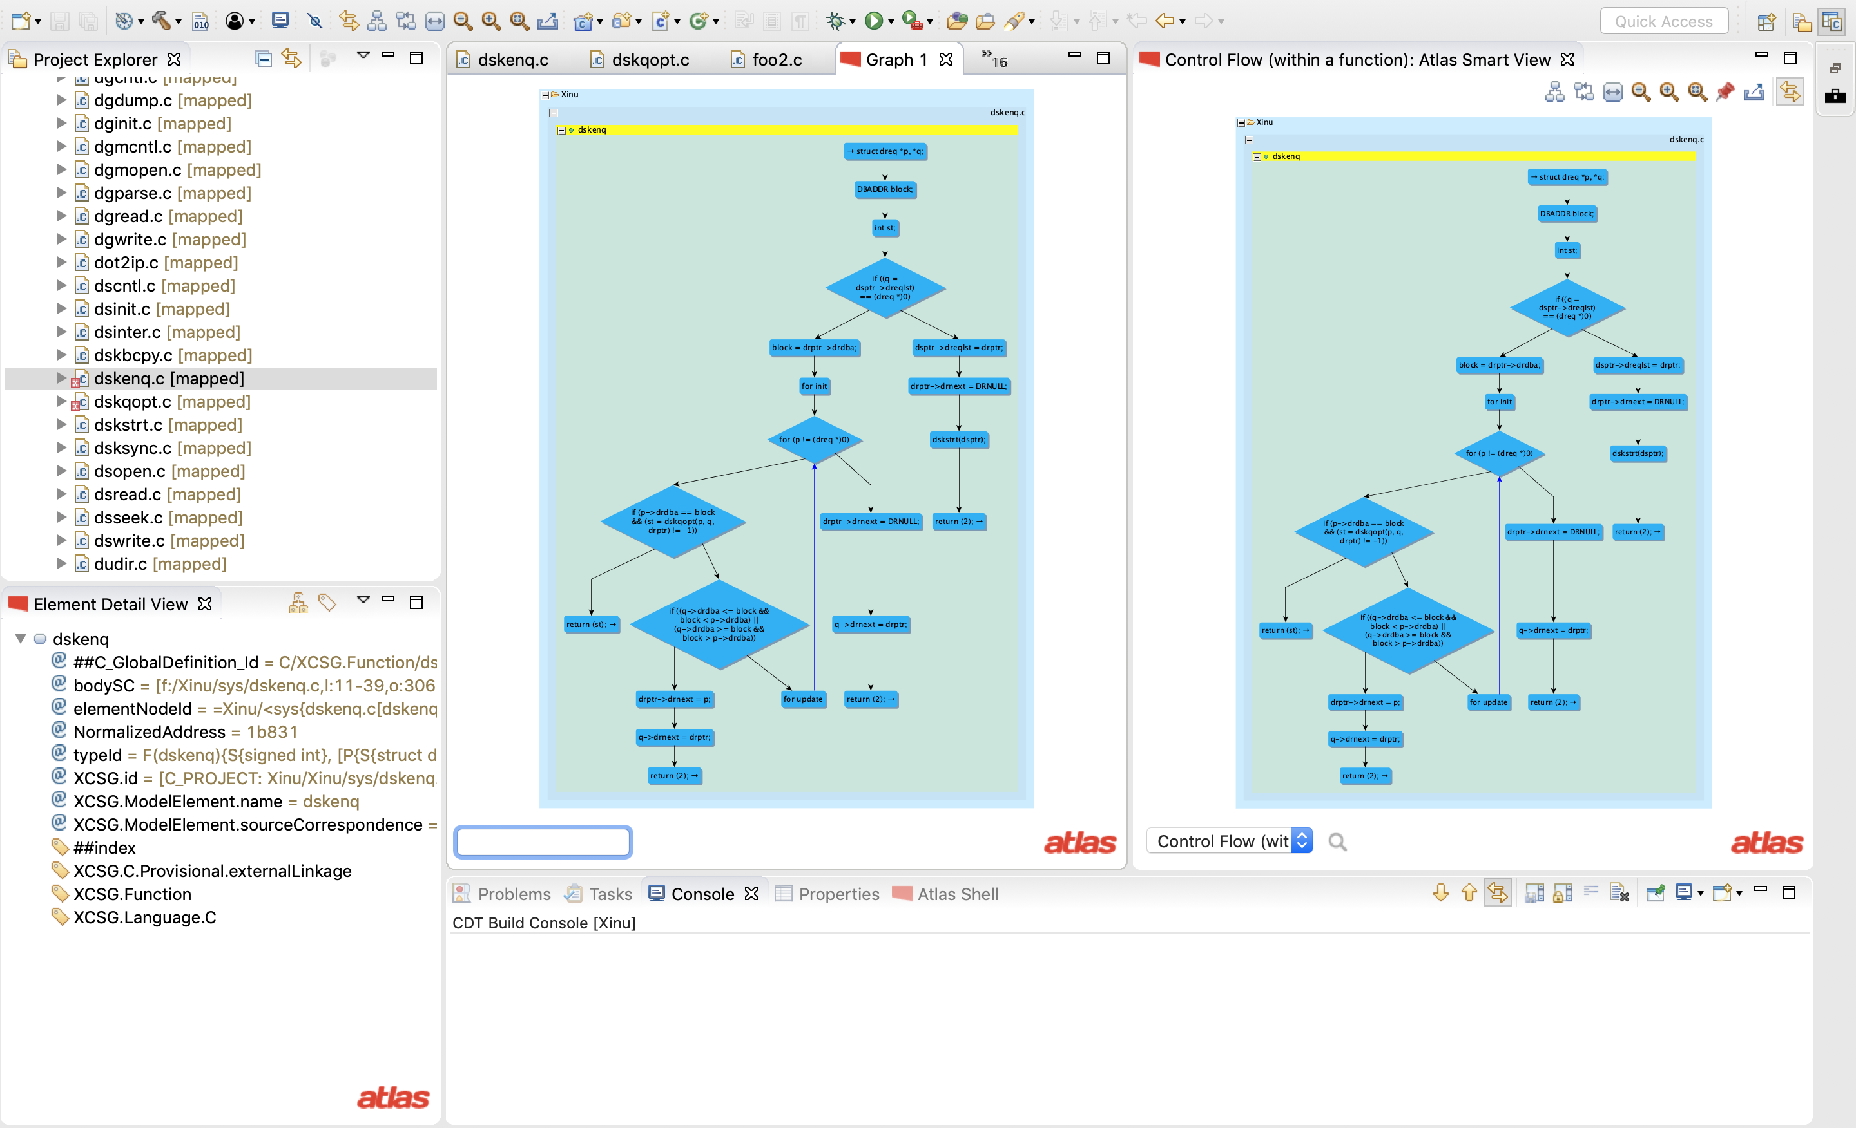
Pinned Model

Slide 5
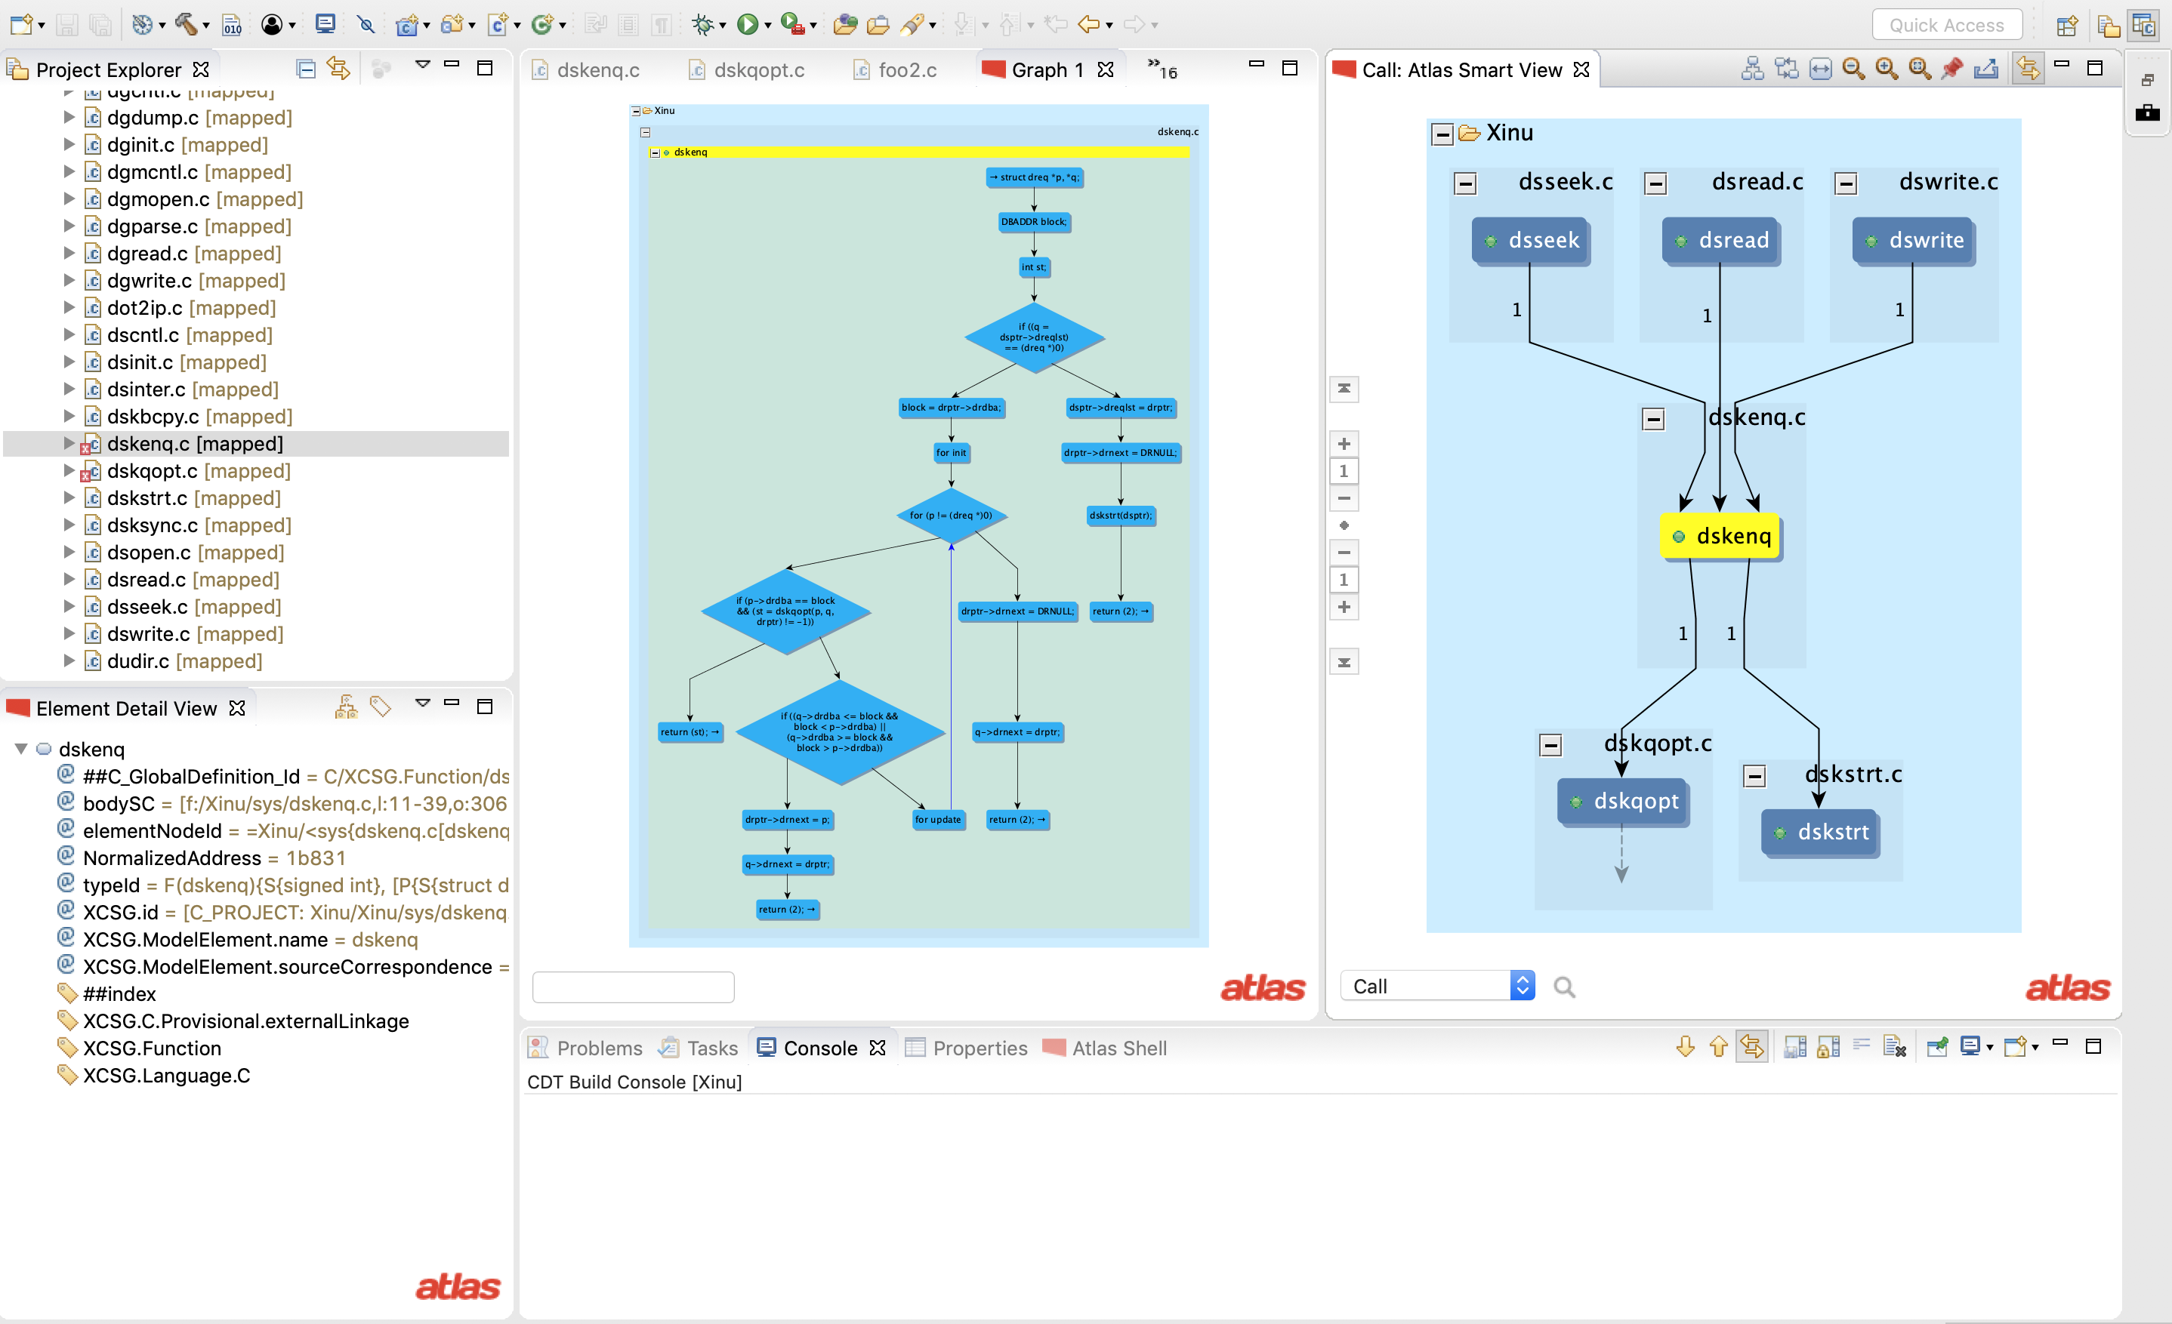
Call Graph of dskenq
A new model type

Slide 6
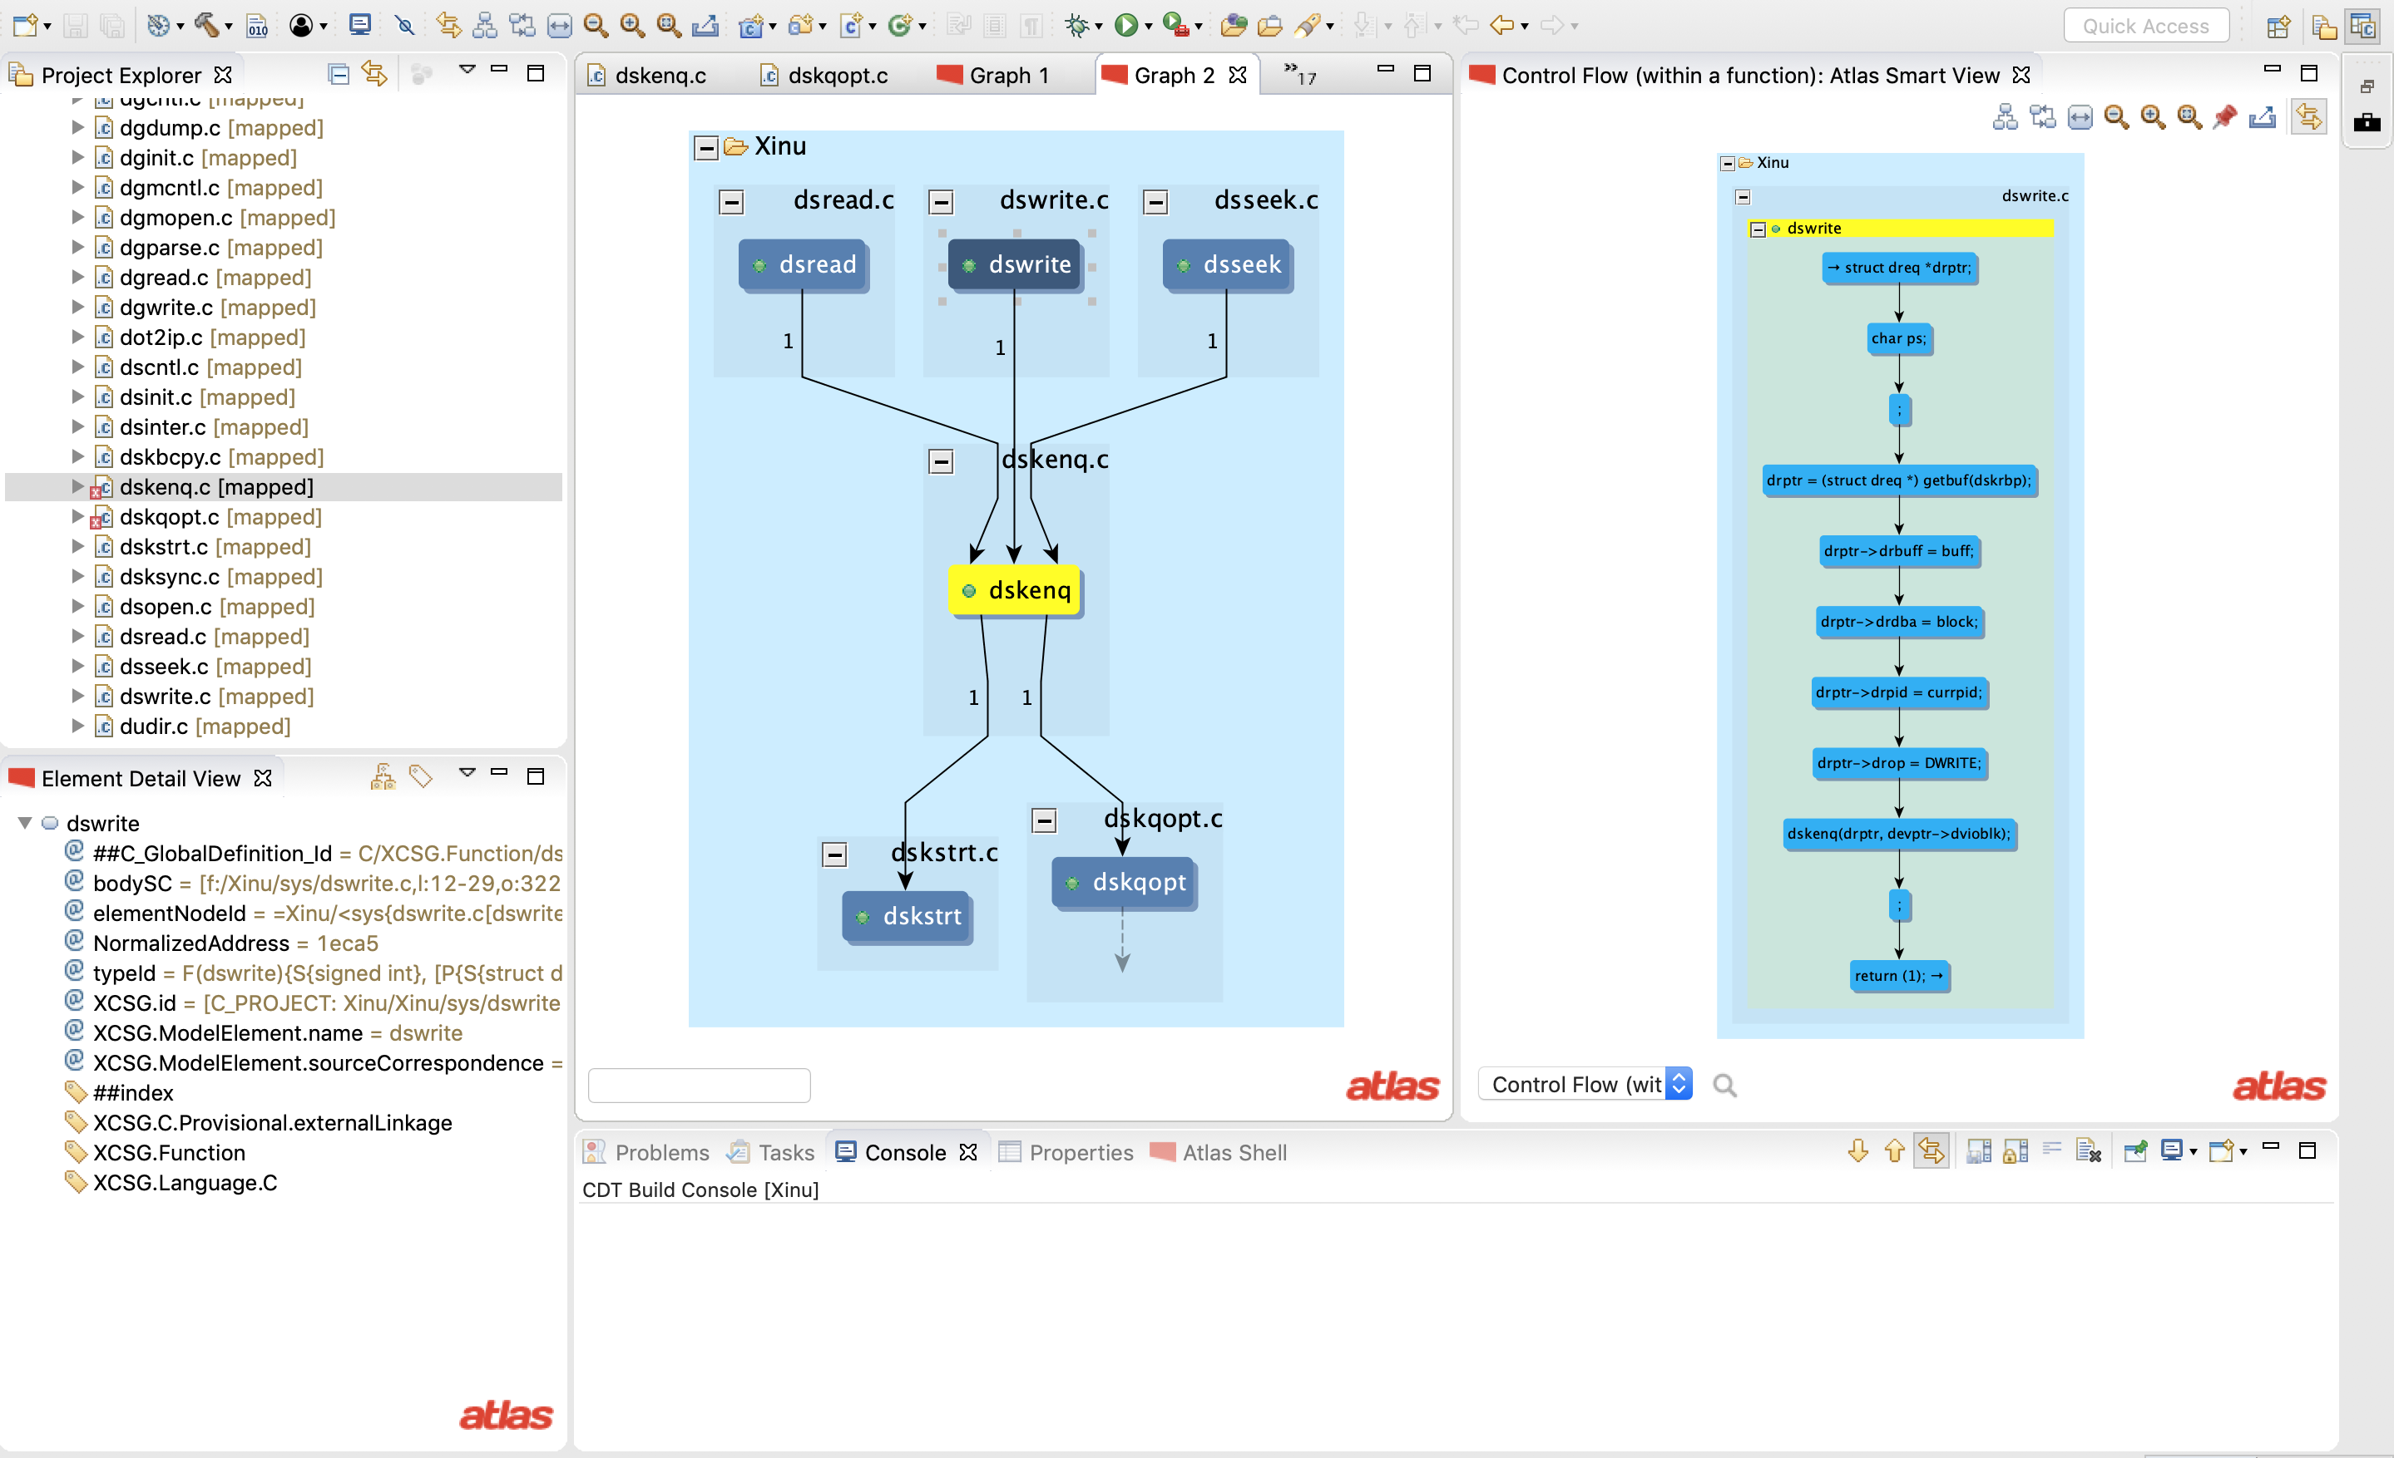
Click on dswrite
Call graph is pinned
CFG of dswrite
Select CFG SmartView

Slide 7
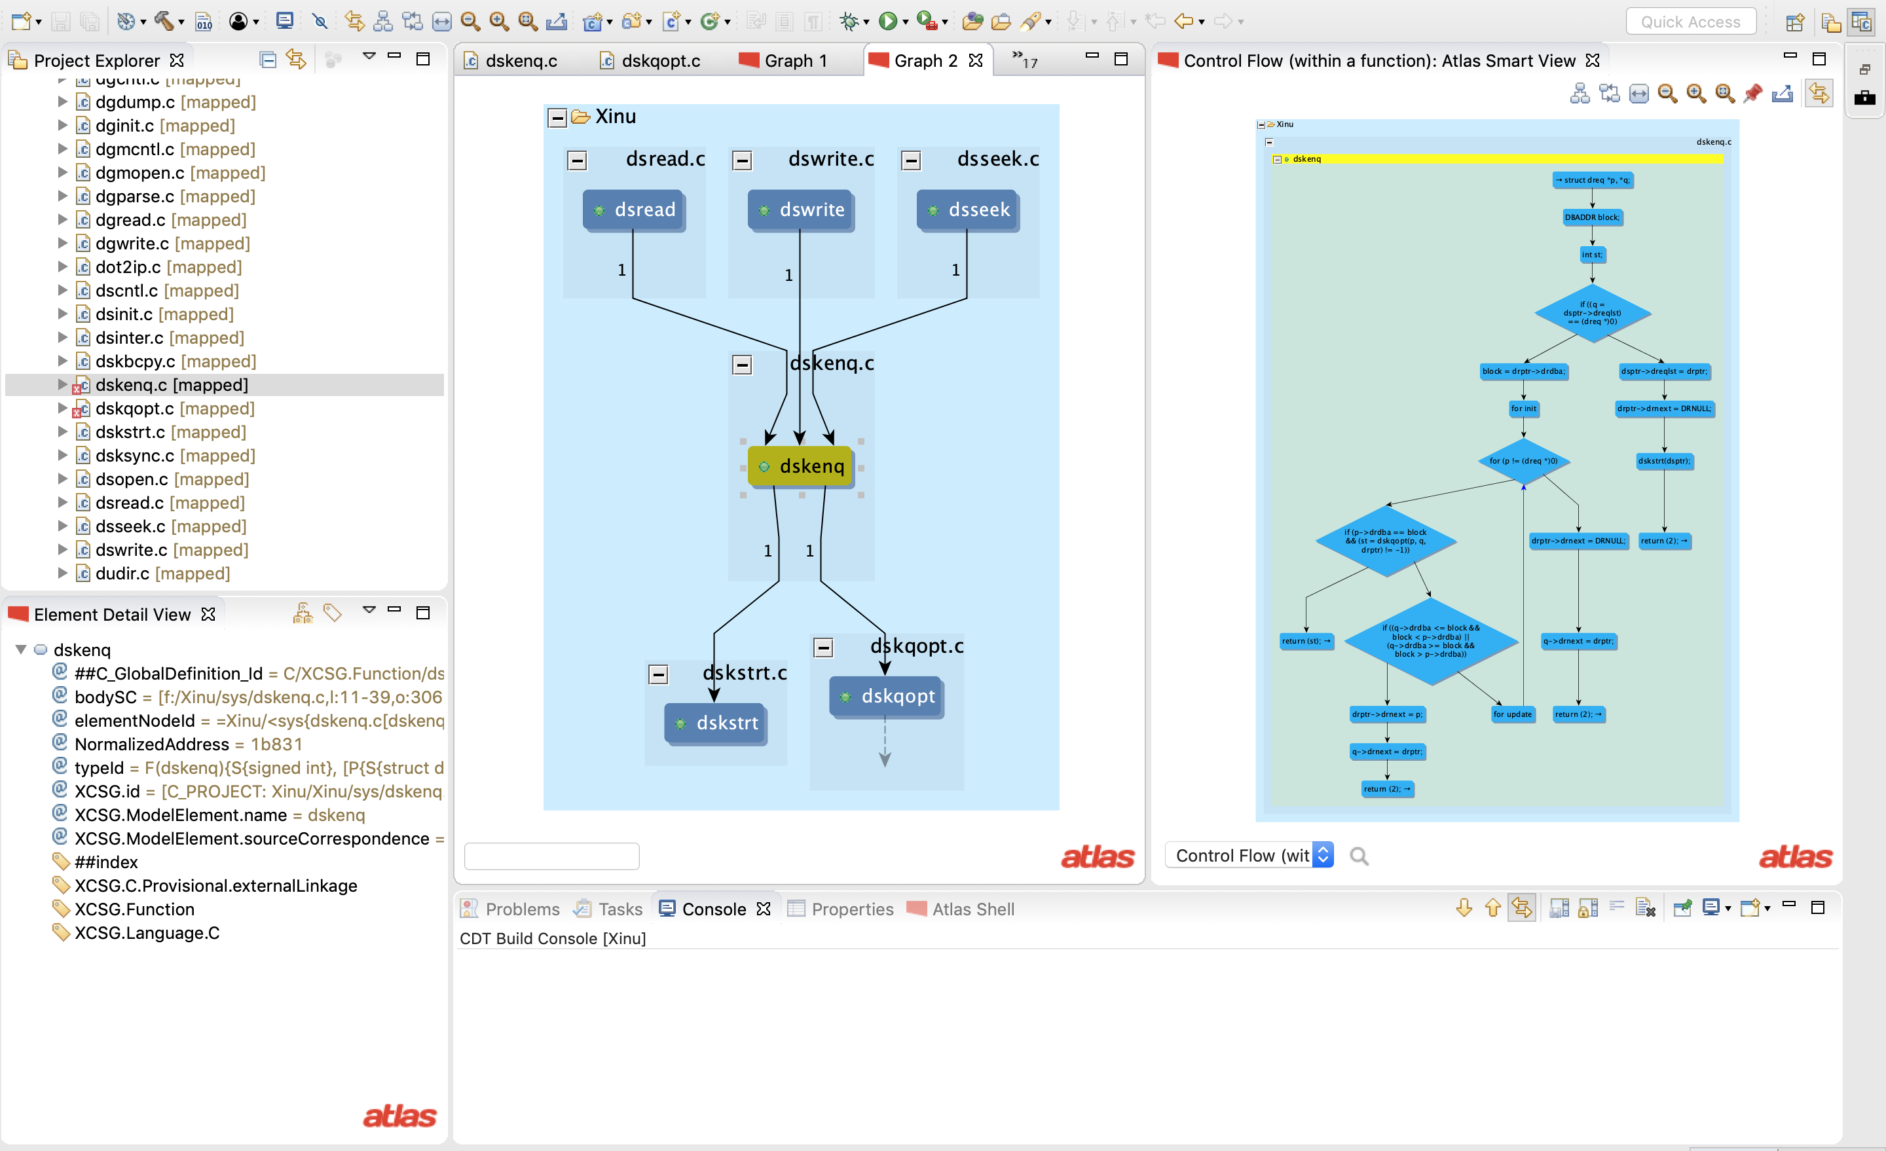
Click on dskenq
CFG of dskenq

Slide 8
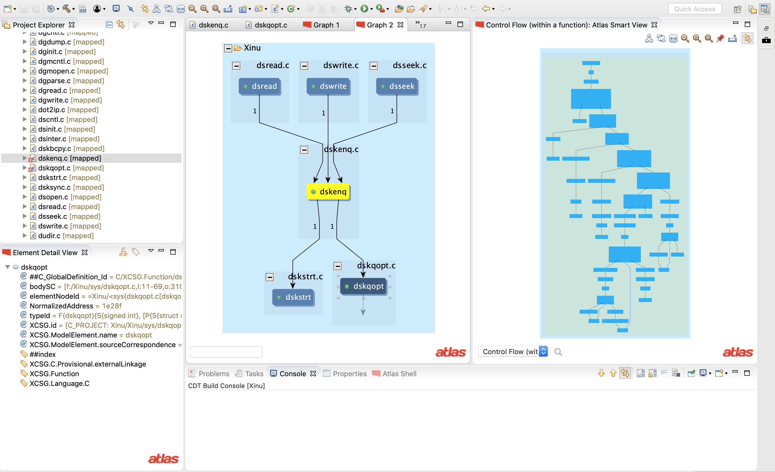
Click on dskqopt
CFG of dskqopt
Select CFG SmartView

